Slide 1
Linear Feature Engineering
Abhinab Acharya, Jeevan Thapa

Slide 2
Table of Contents
Data Analysis
Feature Selection
Model Evaluation

Slide 3
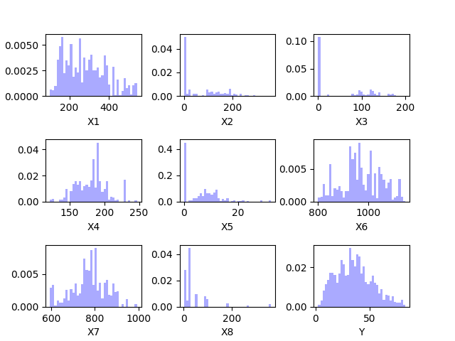
Data Distribution
General Idea of Data
Some Uniform
Some Skewed
Remove or Transform
8 Features
926 Examples

Slide 4
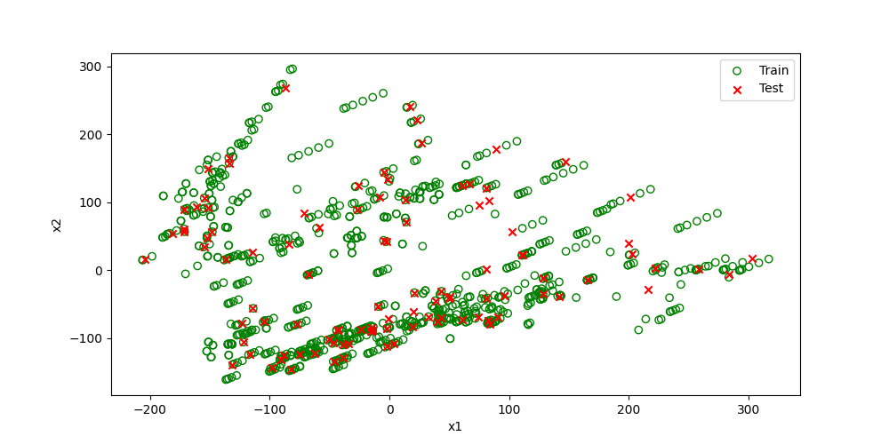
PCA: Train and Test Distribution
x1 and x2 from PCA
Train and Test data follow similar pattern

Slide 5
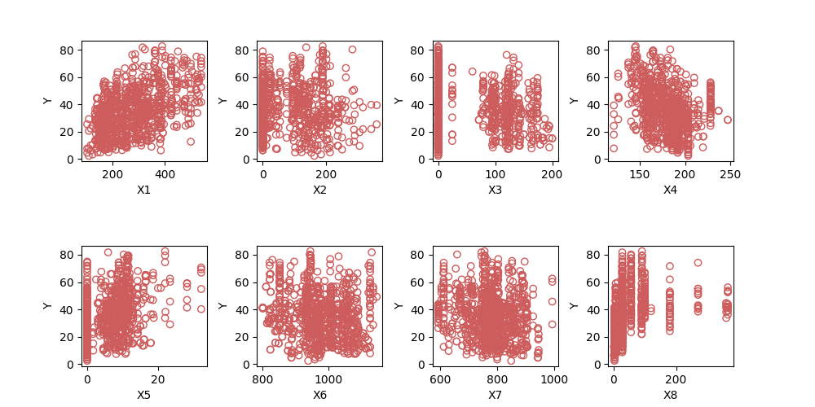
Individual Feature vs Target
Relationship
Not simple
Stacked on zero

Slide 6
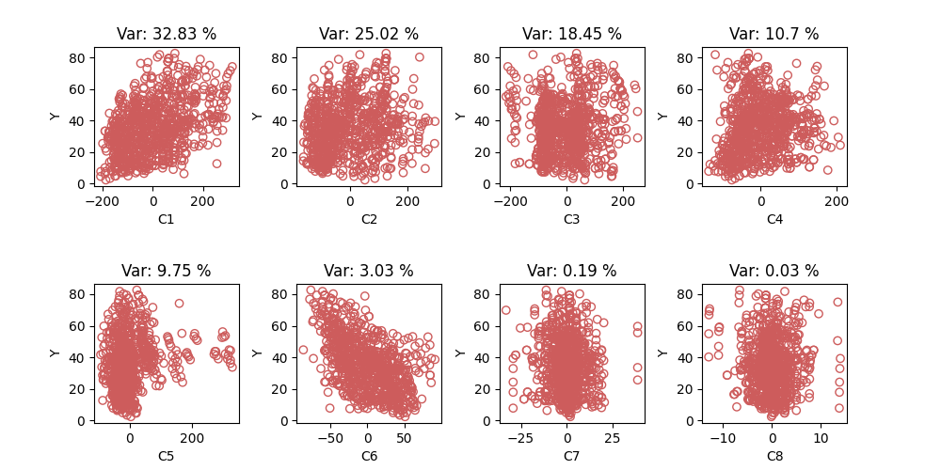
PCA: Variance
Are features important?
Distributed among few components

Slide 7
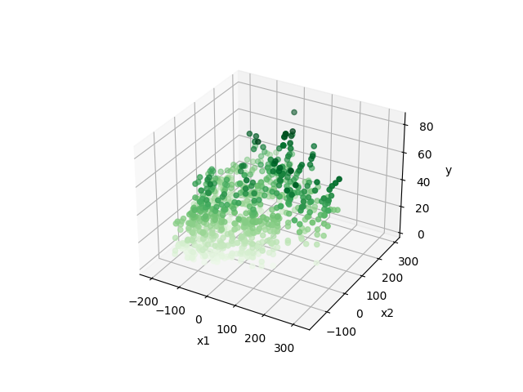
PCA: 3D Plot
High variance components
Two components vs target
Shade of color represents depth

Slide 8
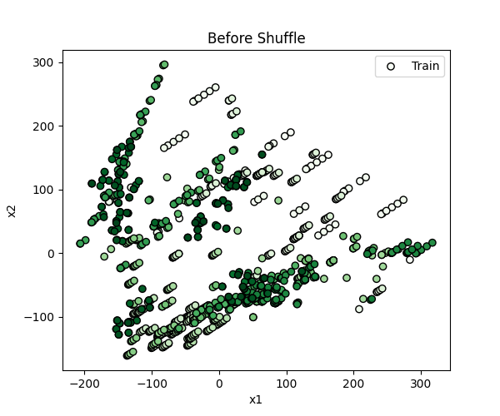
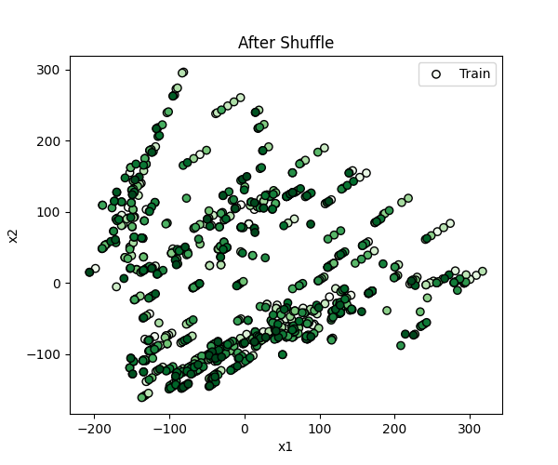
PCA: Data Order
Color represents the order

Slide 9

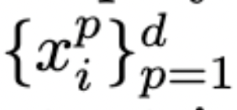
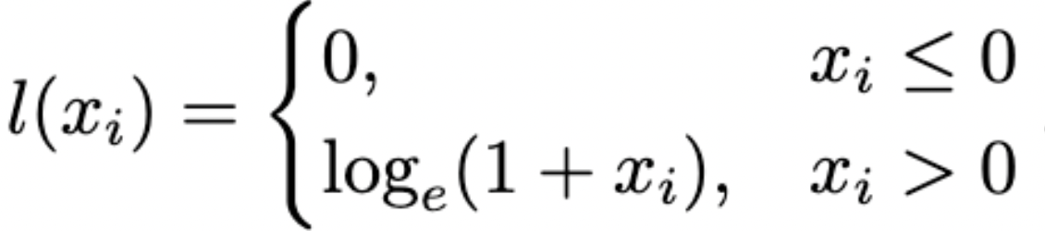
Features Used
Linear Regression Model
Polynomial expansion
Given , generate
Sin transformation
Given , generate
Logarithm transformation

Slide 10
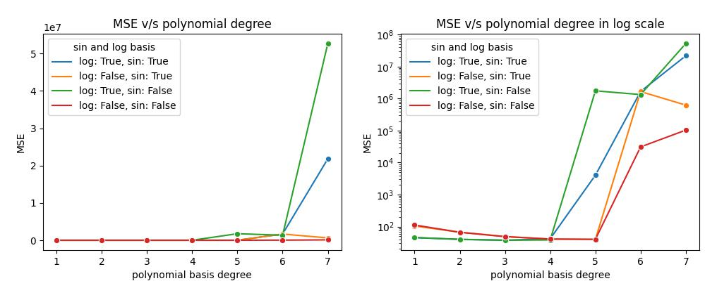
Cross Validation Results
Least Loss Model: (polynomial degree: 3, include sin: True, include log: True)

Slide 11
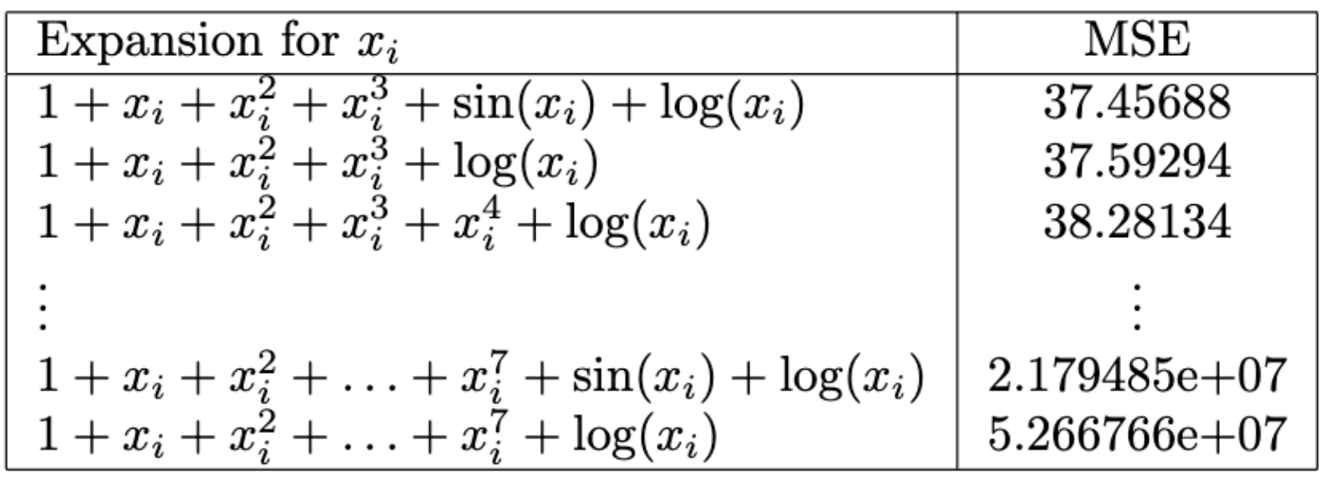
Final Training Results
*

Slide 12
Final Training Results
Train MSE loss: 32.59
Predicted Test MSE loss: 37.46

Slide 13
Thank you!

Slide 14
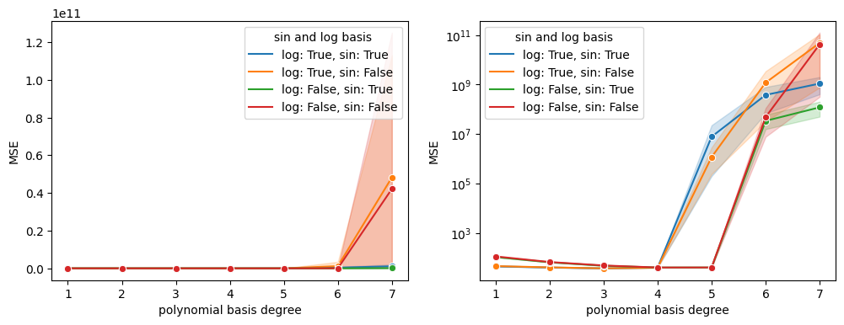
Cross Validation Results

